Slide 1
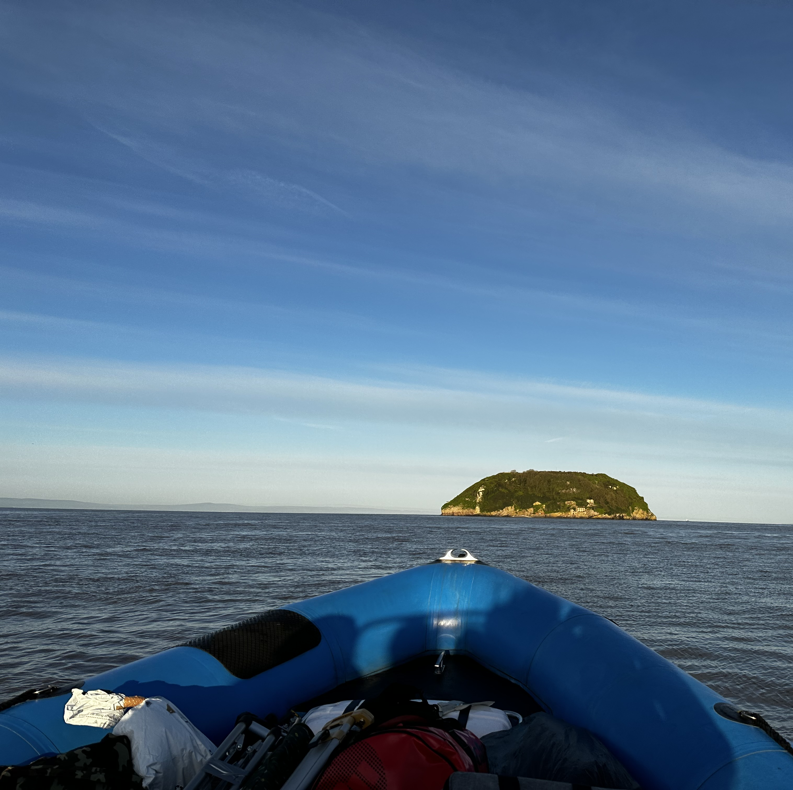
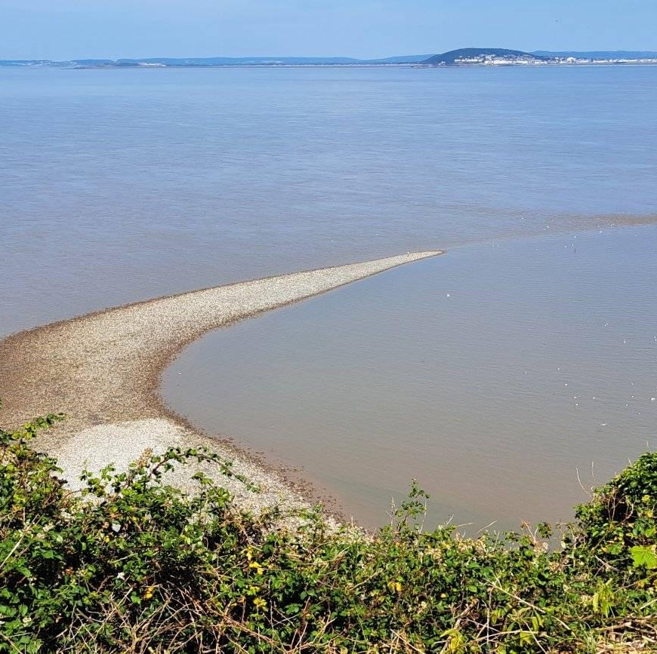
Steep Holm Health & Safety
A tour around the island

Slide 2
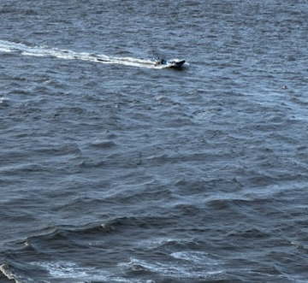
Boat safety and landing
Arrive early to attend the safety briefing
Wear an extra layer. It gets cold out there even on sunny days (you can take it off but can’t put it on if you don’t have anything)
Put on your life belts and secure – help is on hand – follow the instructions of the crew
Sit in the seats and hold on – it can get choppy, and we won’t sail above 5 knots wind speeds, but weather can change so bring wet resistant gear
Do not stand, sit back and enjoy the ride
The landing onto a pebble beach requires some agility
Steps are provided and move away from the shoreline to the assembly point
Steep steps up to the quay and stay away from the edge

Slide 3
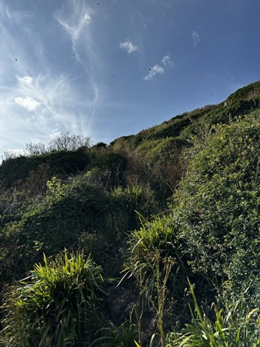
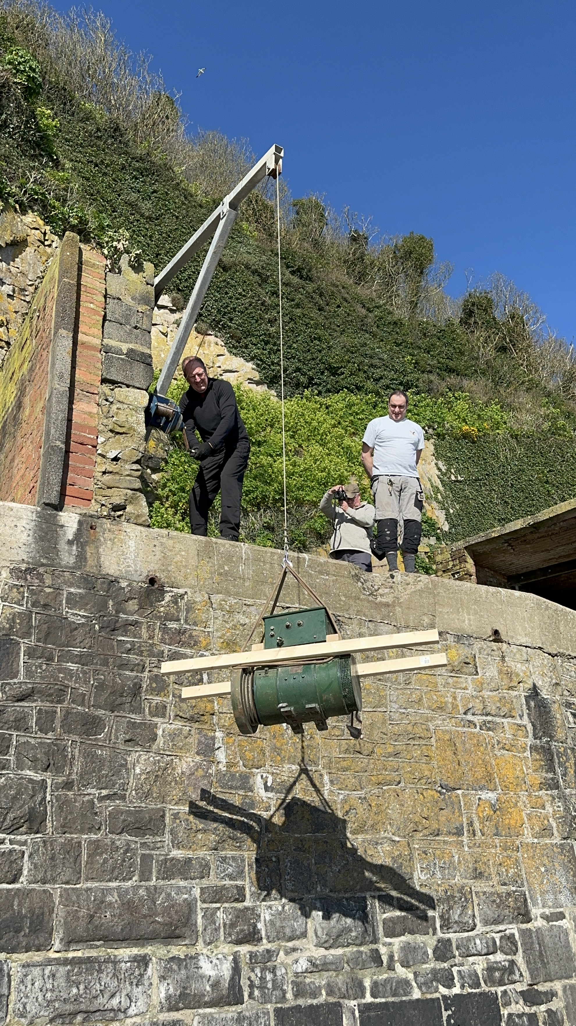
Climb to the top
Wear sturdy footwear e.g., hiking boots. Flip flops and slippers are not suitable.
There are old rail tracks on the way up that can be slippery and a trip hazard
Do not enter the old pub which is unstable. The floor could collapse, or stones fall on your head
Keep away from the edge and make your way safely to the top
Watch your footing and take your time

Slide 4
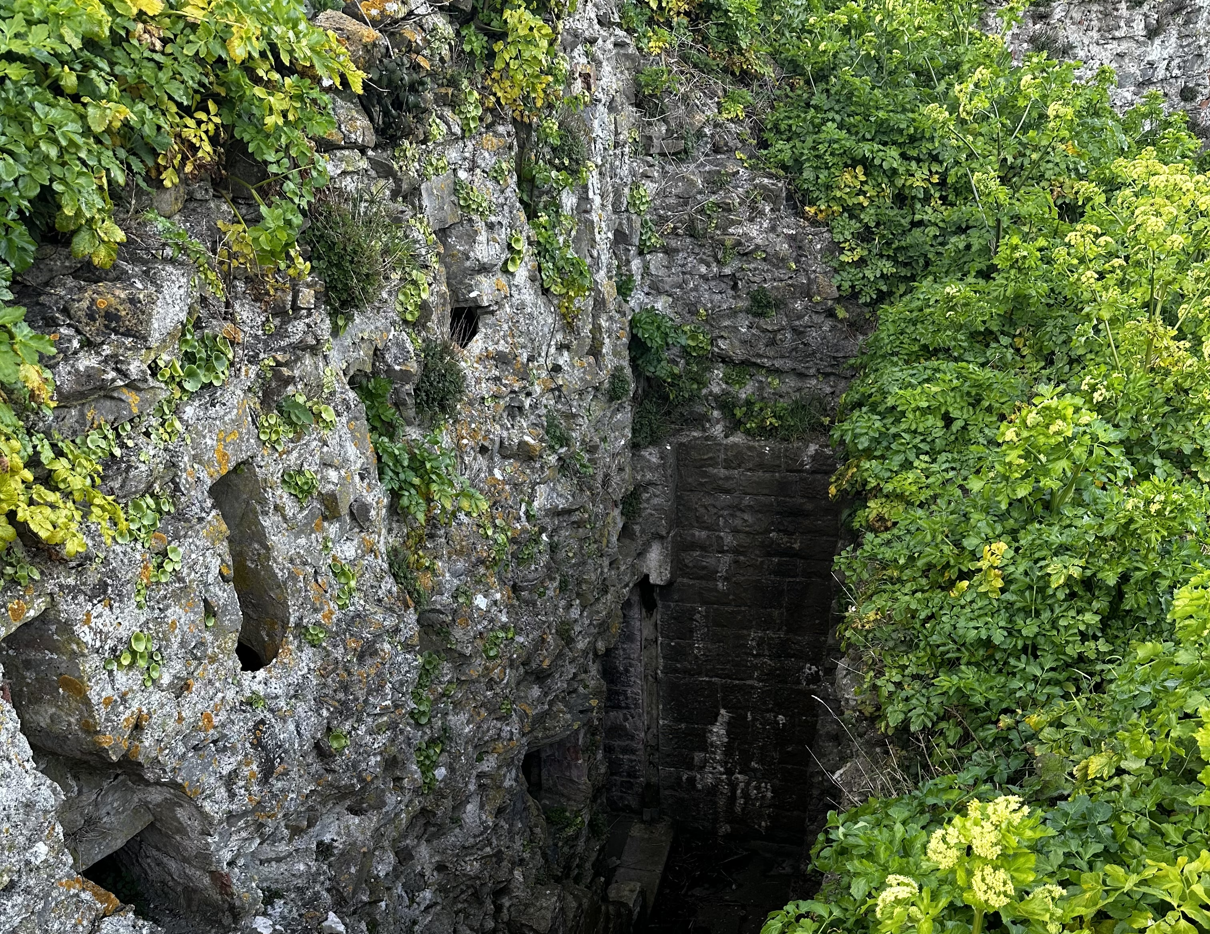
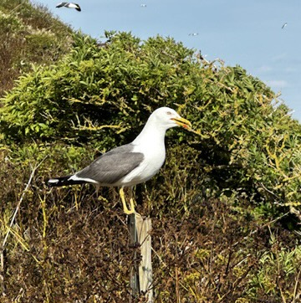
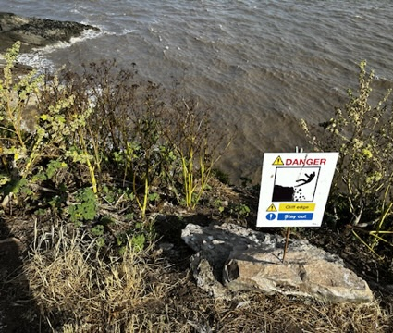
Steep steps and cliff edges
There are steep steps leading into the gunpowder rooms by the gunneries
The steps to the look out are steep so use the railings installed by our deputy warden – there is no lift to return to the top!
Beware of the cliff edges and stay on the footpaths
Do not go too close to the quay edge
Avoid climbing walls and structures
Avoid the brown moth webs in early Spring as they are highly irritant
There are poisonous plants so be cautious

Slide 5
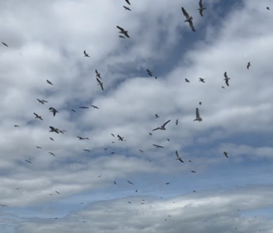
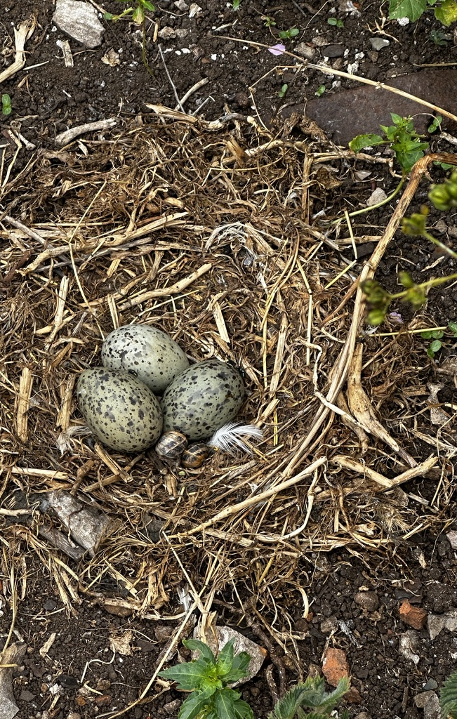
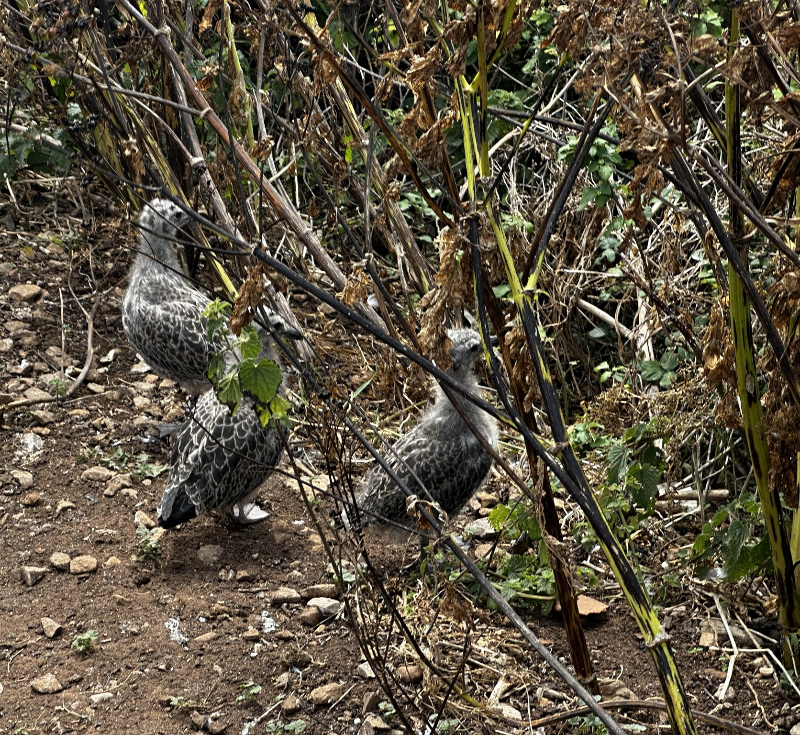
Sea birds in the nesting season
From mid April to mid July the seabirds are nesting, and you will find nests on the paths
Sea gulls are a threatened species and declining in numbers, so avoid the chicks and eggs
Wear a hat! They will dive bomb and mess on you so keep your hat on and move on. A stick held high is effective. Umbrellas are also available to hire from the barracks
Early Spring, later Summer and Autumn sailings are more peaceful with the gulls
Do not go near birds that appear to be sick or touch dead birds (bird flu is rarely transmitted to humans but do be cautious)

Slide 6
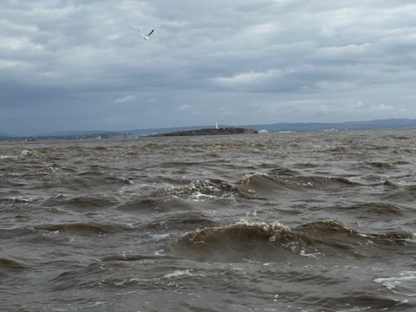
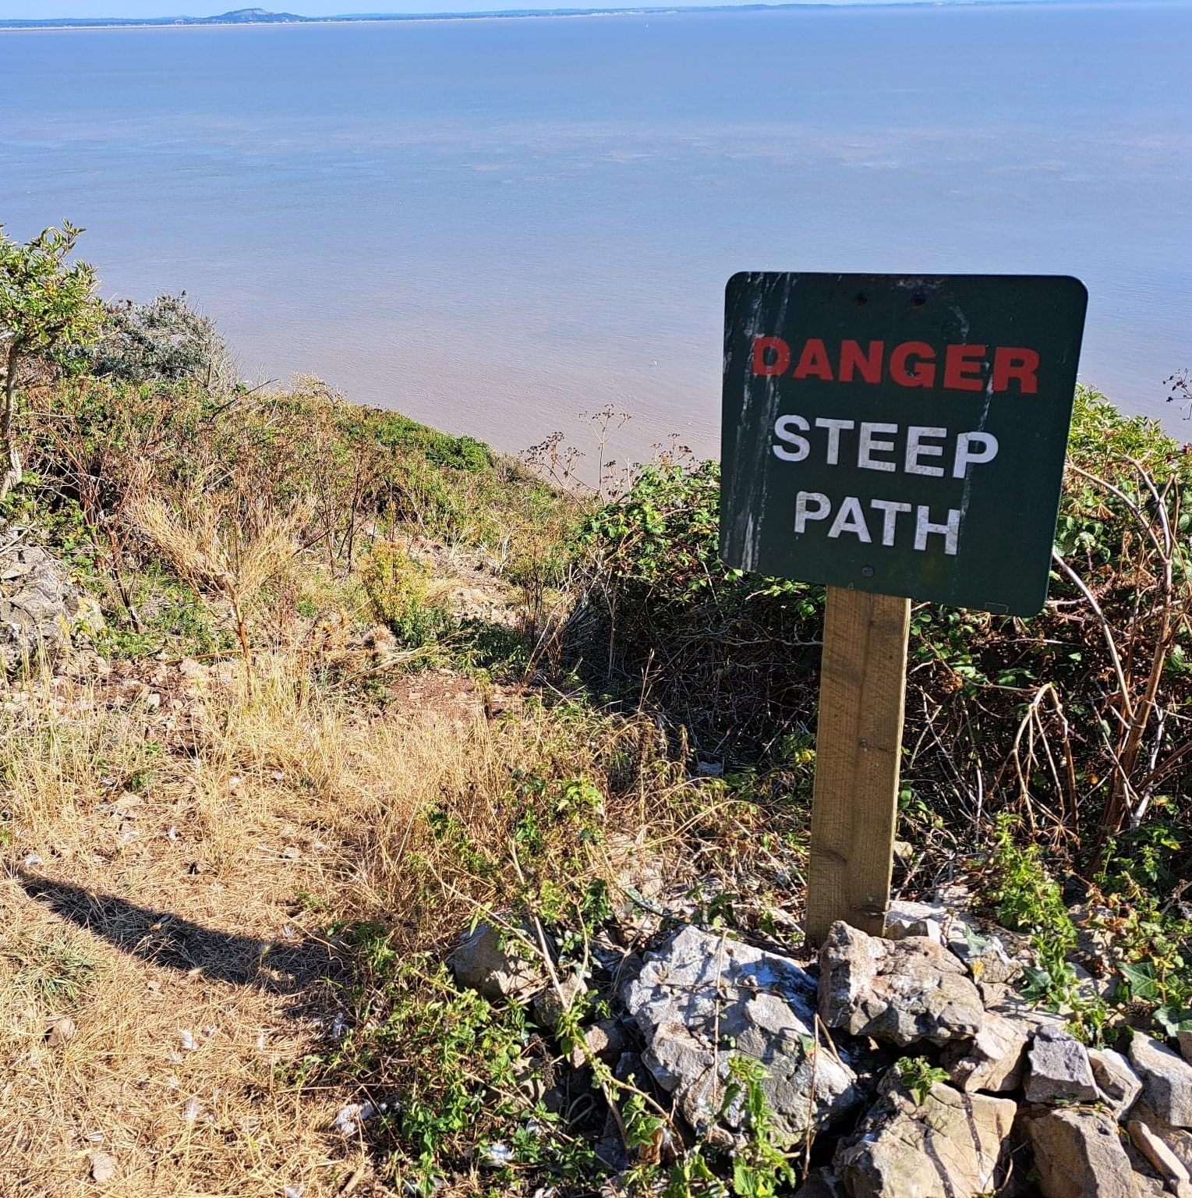
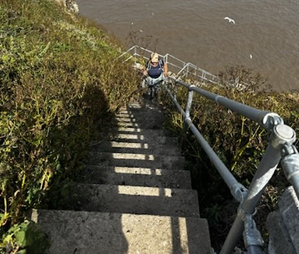
Danger path and currents
There is a steep path to the south landing near the barracks. It is very steep and at the bottom it does not have railings so keep away from the edge. Do not attempt unless you are fit enough to get back up.
Do not swim. The current runs at about 4 knots and will take you miles out to sea
The Bristol Channel has the 2nd highest tide in the world
208 look out, as the name implies, has 208 steps so make sure you can climb back up and use the railings

Slide 7
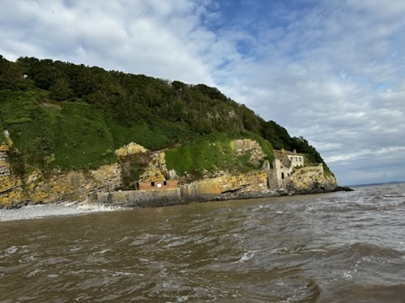
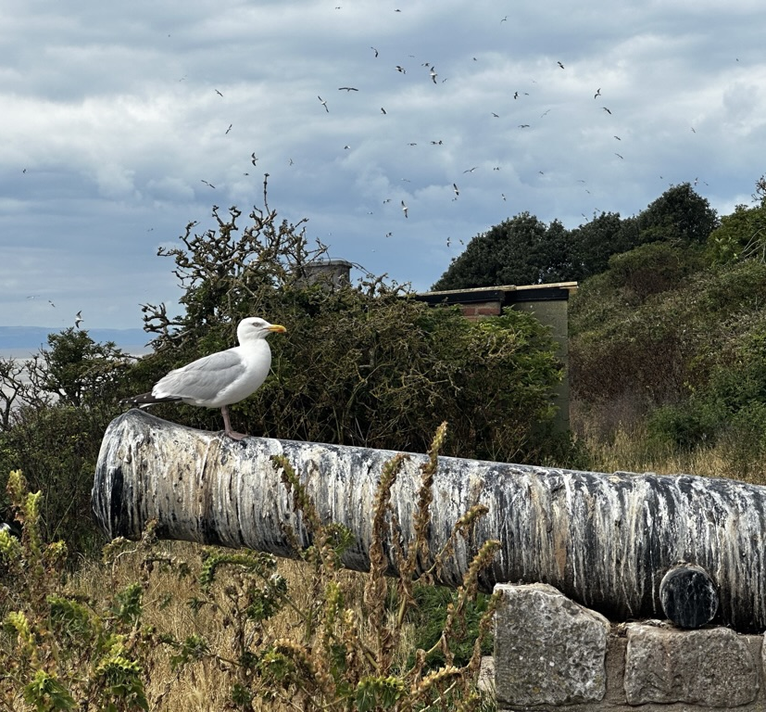
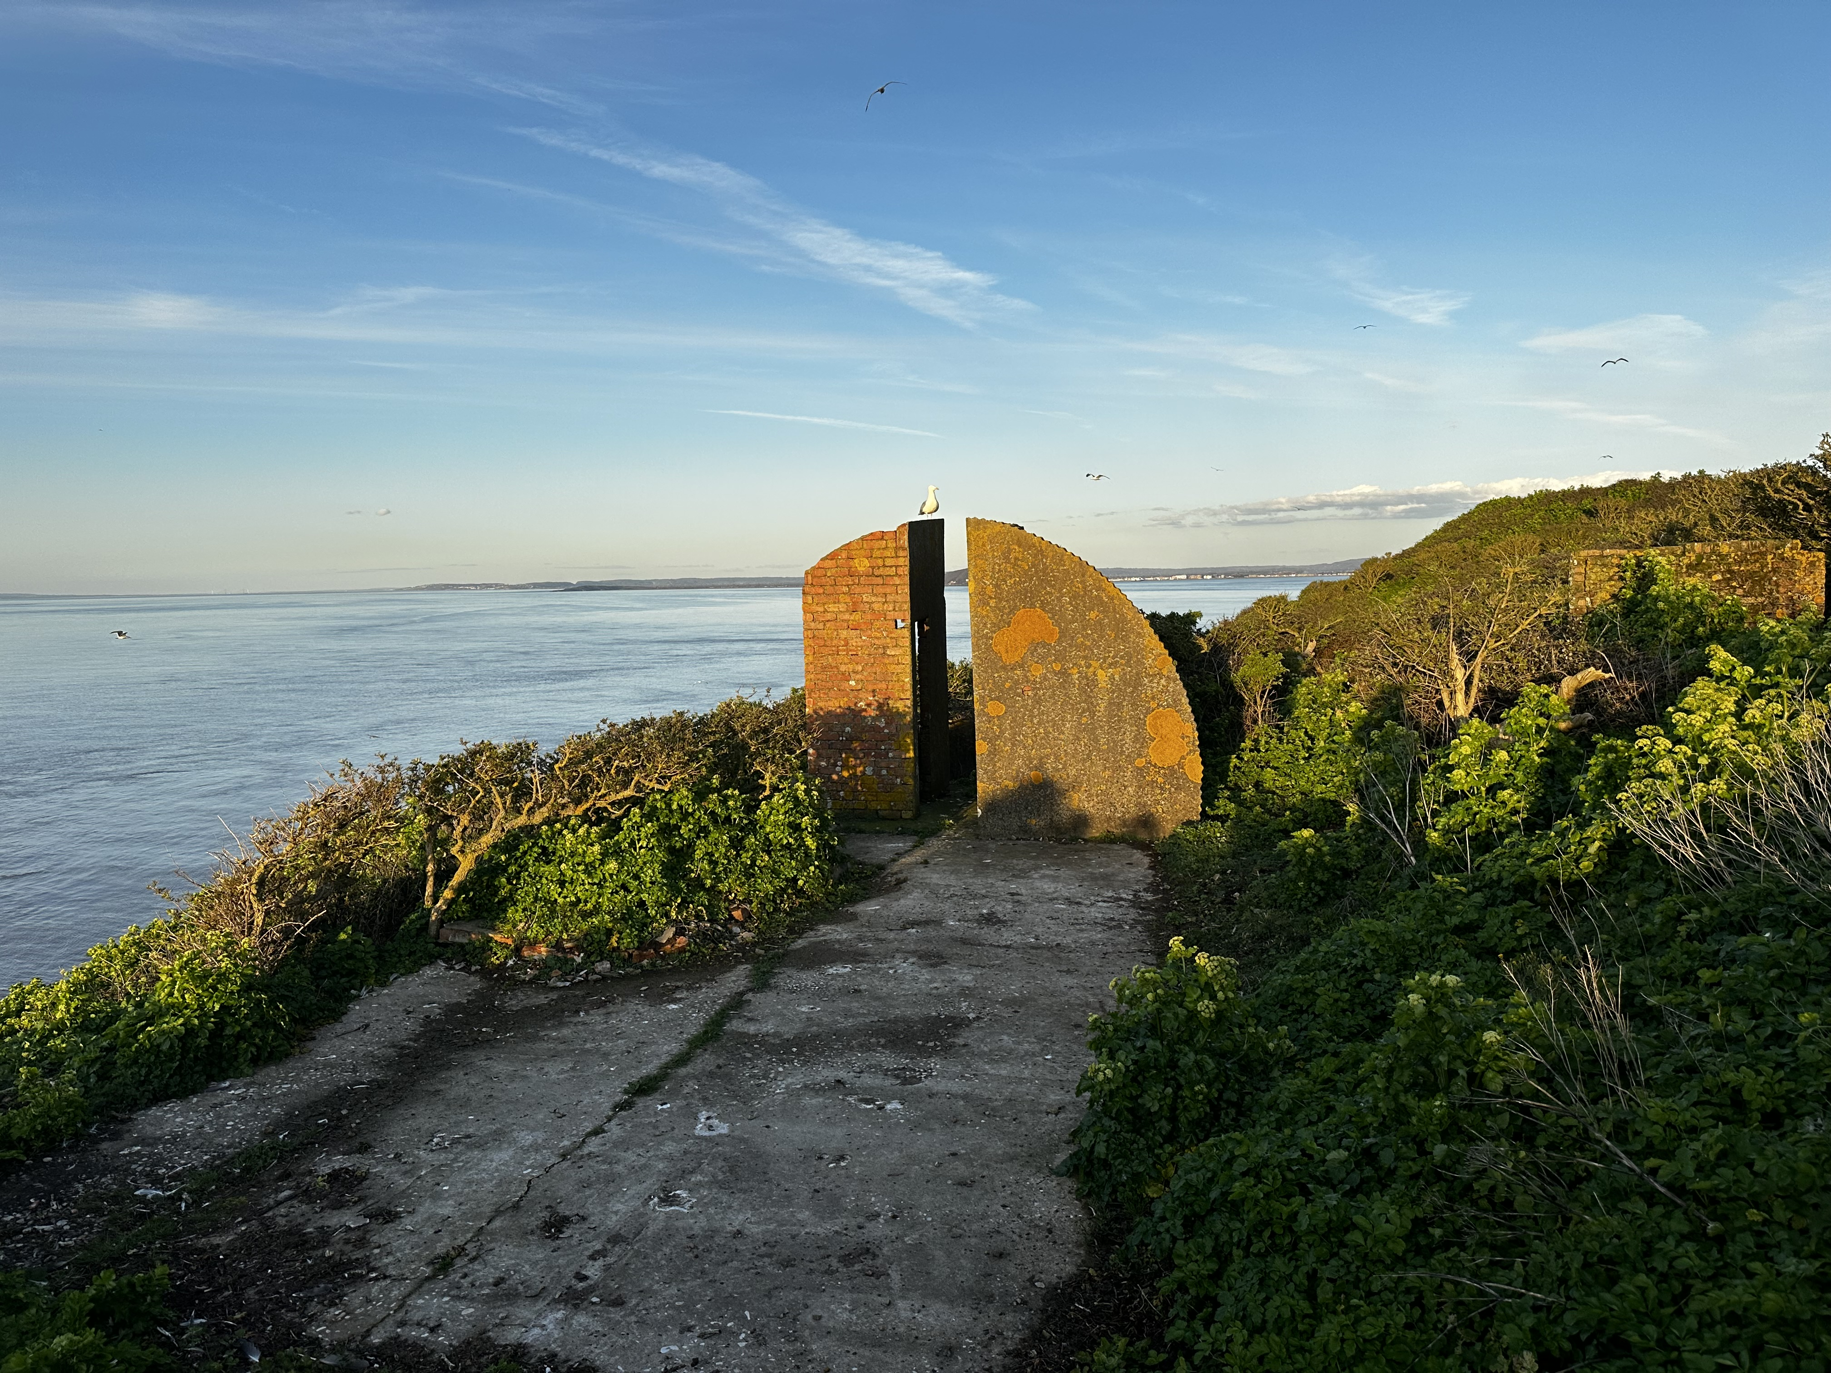
Enjoy and stay safe
Steep Holm is beautiful, and some common sense will keep you safe
Use your phone for photos. You may want to bring your own portable charger
You may get 4G but depends on the weather so not guaranteed.
Cards accepted if we get a signal! Bring some cash to be sure
The tide times means your stay is for 12 hours so bring some lunch
Drinks, alcohol and snacks are available in the barracks plus souvenirs and books but do walk around the island and enjoy the views of the Welsh and Somerset seashores

Slide 8
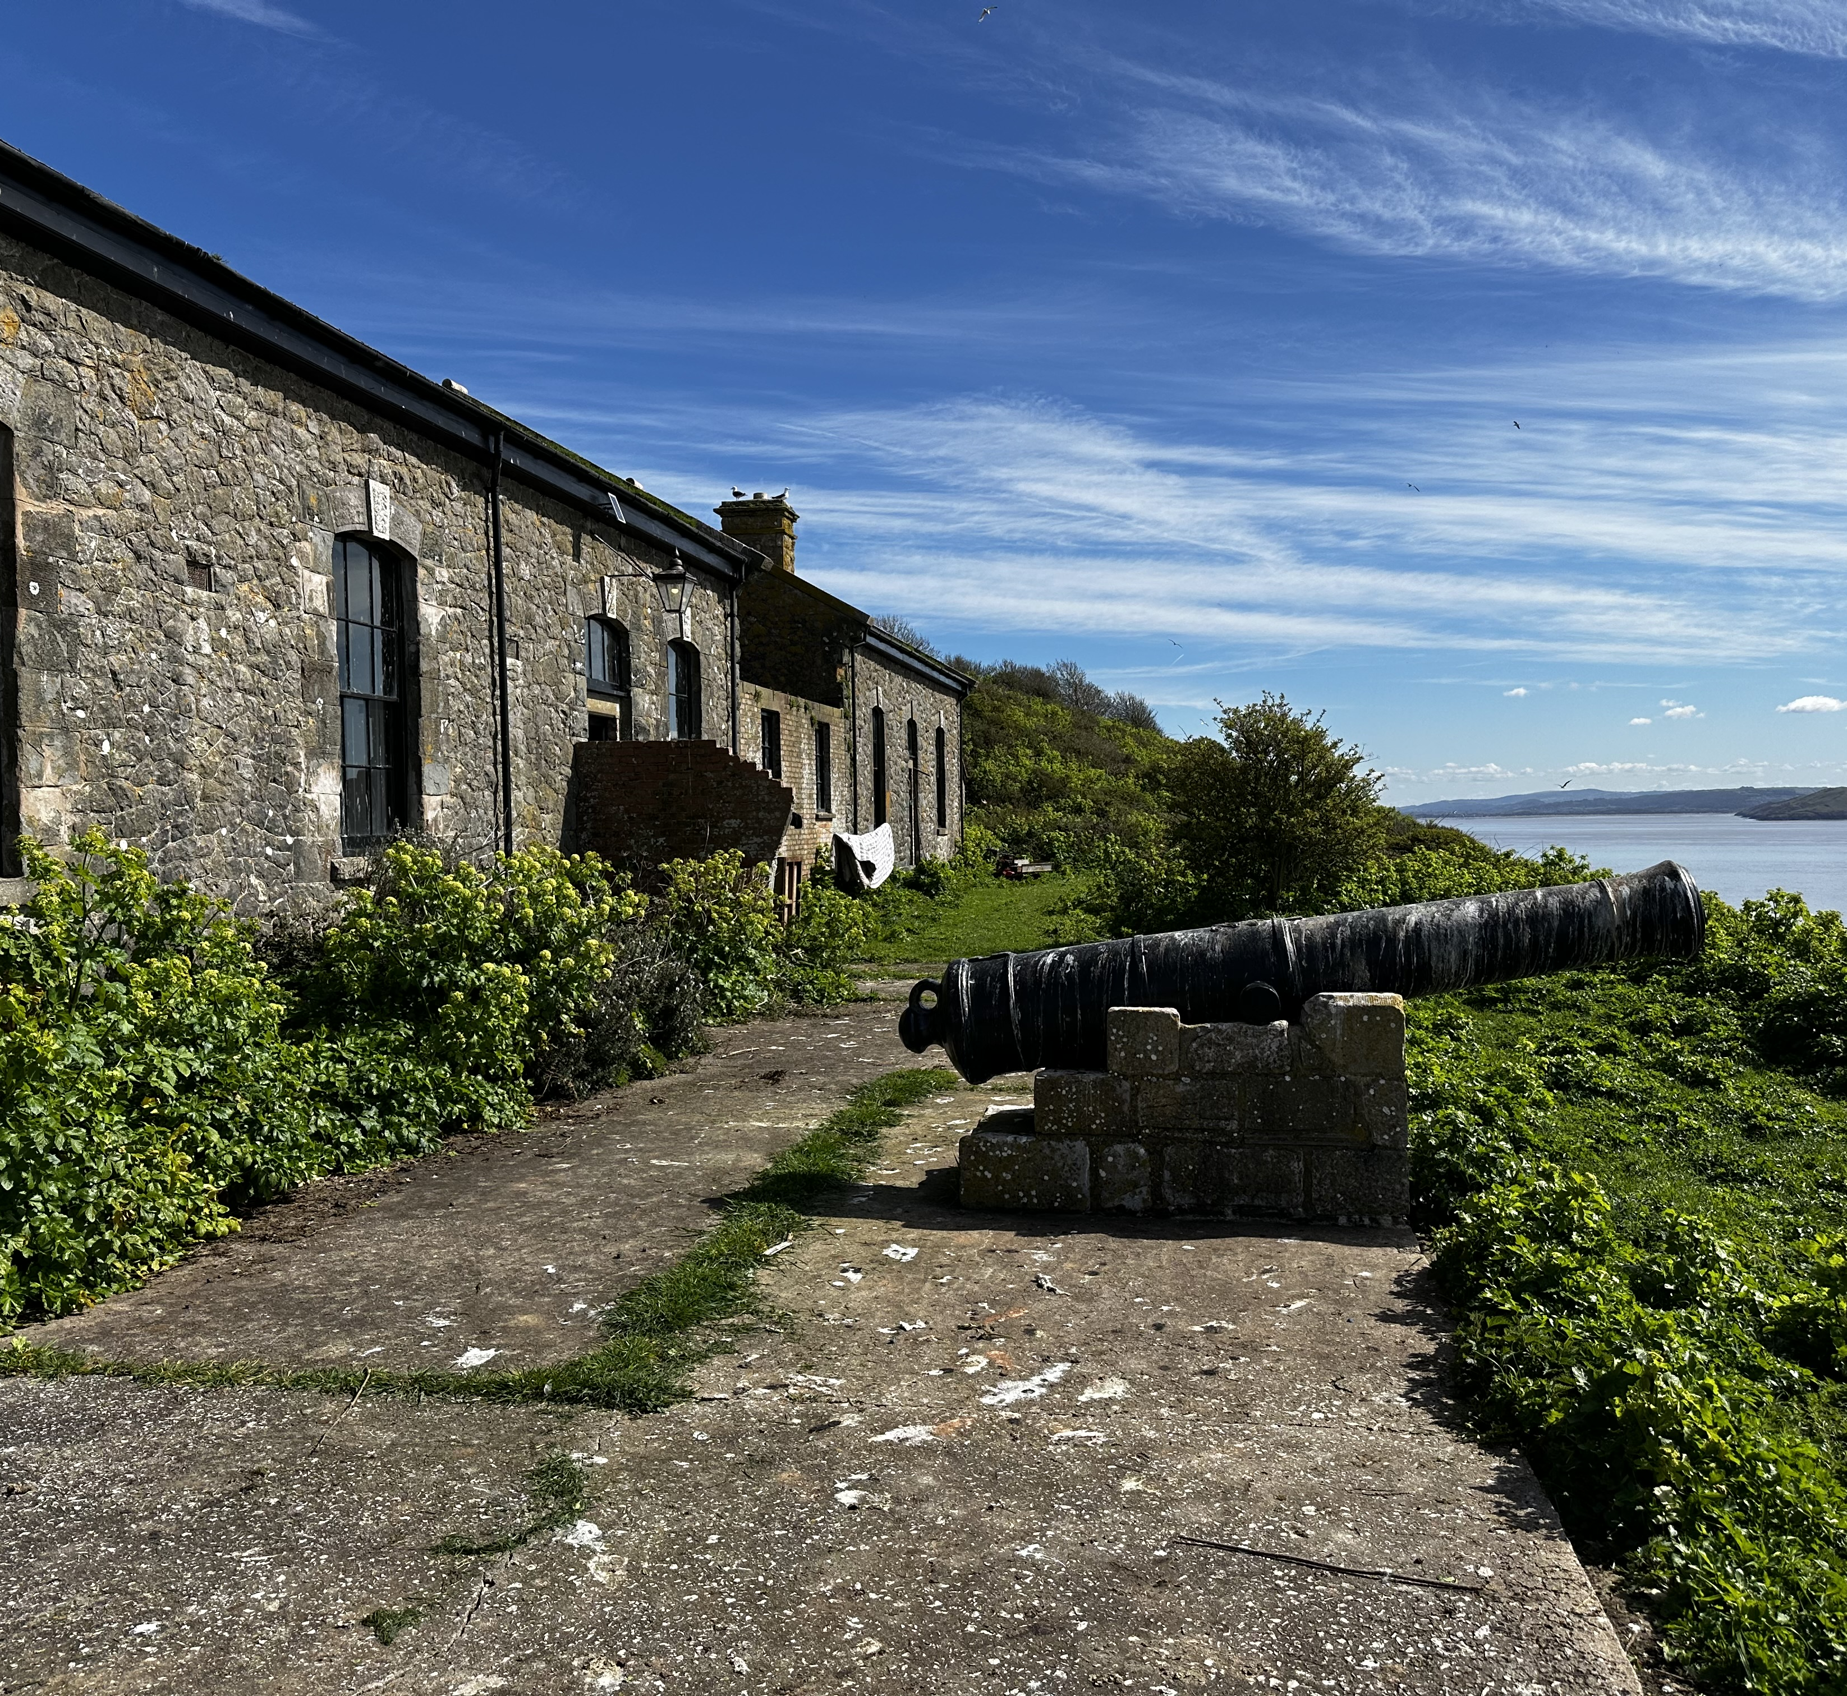
Any questions
The warden will give a talk if available and volunteers are available to answer your questions on the day
New volunteers are welcome. Join as a member (£25 per annum) and ask for further details. Tasks are onshore as well as offshore (e.g., fundraising, trustees or minute takers). If you have skills e.g., builders, electricians, plumbers, dry stone wallers, that’s handy!
www.steepholm.online

